Slide 1
The Battle of the Neighborhoods

Slide 2
Introduction:
Optimal Location for new businesses.
Business Problem:
Low competition
High demand
Easy to replicate
Success Criteria:
Best neighborhood which meets above critera

Slide 3
New York City:
The city of New York has a population of 8.623 million. It is a diverse, multicultural, global hub for business, fashion, tourism, media, theater, and the arts (Among many other things). With that said, this means that the market is extremely competitive, thus making it useful for new businesses to analysis the market carefully, in hopes to either find a niche market, or to see what has been successful in the pertained area.
New York City is a prominent location for outstanding cuisine. The City has been described as a "melting pot" of international influences that can be tracked by its union of many nationalities, cultures, and ethnicities. New York City is a place where over 800 languages are spoken and is the quintessential "melting pot" of the USA.
Most of, if not all, of these influences come directly from the vast history of immigration to New York City.
For example, much of the cuisine usually associated with New York City stems in part from its large community of Ashkenazi Jews and their descendants. The world famous New York institution of the "Delicatessen," commonly referred to as a "Deli," was originally an institution of the city's Jewry. Much of New York City's Jewish fare has become popular around the globe, especially bagels. (New York City's Jewish community is also famously fond of Chinese food, and many members of this community think of it as their second ethnic cuisine).

Slide 4
New York City - Business Environment
Market is highly competitive
New businesses need to be analyzed carefully
One should strategically target the market to help reduce risk & the return of investment will be reasonable.

Slide 5
New York CIty - Cuisine
The City of New York is famous for its diverse cuisine. It’s food culture includes an array of international cuisines influenced by the city’s immigration history.
The most popular and well known being Italian and Jewish cuisine.
New York-styled pizza, New York-styled cheesecake, etc.

Slide 6
Factors to look into:
New York Population
New York Demographics
Cuisine Served
Etc

Slide 7
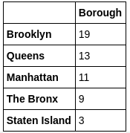
Data Description - One
Data 1: New York City has over 5 boroughs and over at least 154 neighborhoods. In order to segment the neighborhoods and explore them, we will essentially need a dataset that contains the 5 borughs and all the neighborhoods that are in them, as well as the latitude and longitude coordinates of each neighborhood.
The data used in this analysis is from: https://geo.nyu.edu/catalog/nyu_2451_34572

Slide 8
Data Description - Two
Data 2 : The following data has been extracted from the links below.
New York Population
New York City Cuisine
https://en.wikipedia.org/wiki/New_York_City
https://en.wikipedia.org/wiki/Portal:New_York_City
https://en.wikipedia.org/wiki/Economy_of_New_York_City
https://en.wikipedia.org/wiki/List_of_Michelin_starred_restaurants_in_New_York_City
https://en.wikipedia.org/wiki/Cuisine_of_New_York_City

Slide 9
Data Descrpition - Three
Data is from Foursquare.
New York City geographical coordinates data will be utilized as input for the Foursquare API, that will be leveraged to provision each neighborhood information.
We will use the Foursquare API to explore neighborhoods in New York City.

Slide 10
Analytic Approach:
New York City has a total of 5 boroughs and about up to 154 or more neighborhoods.
Part 1 - Clustering Manhattan and Brooklyn
Part 2 - Clustering the Bronx and Queens

Slide 11
Methodology:
Data 1 - New York City Geographical Coordinates Data
Load data and explore it using - newyork_data.json
Transform the data of nested python dictionaries into a pandas dataframe
Dataframe contains the geographical coordinates of New York City neighborhoods
Data will be used to get Venues data from Foursquare
Geopy and folium libraries will be used to create a map of New York city with neighborhoods placed on top.

Slide 12
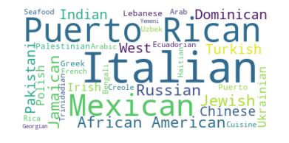
Methodology:
Brooklyn - Most Preferred Cuisine:

Slide 13
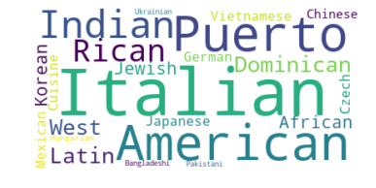
Methodolgy:
Manhattan - Most Preferred Cuisine:

Slide 14
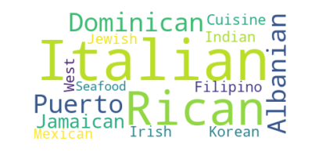
Methodology:
Bronx - The Most Preferred Cuisine:

Slide 15
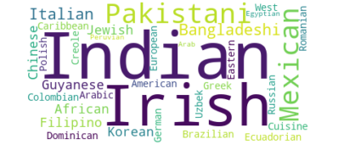
Methodolgy:
Queens - Most Preferred Cuisine:

Slide 16
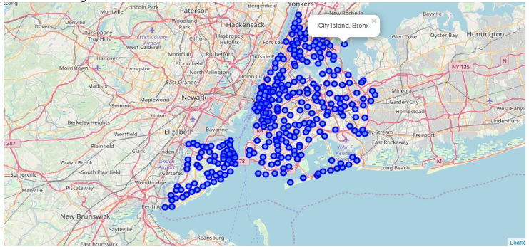
Discussion:
Scope to explore cuisines of various countries in Bronx, Queens, Manhattan, and Brooklyn.
In Manhattan and Brooklyn restaurants, cuisines of many countries are apart of their menu. There is definitely a risk with opening a restaurant in these two areas.

Slide 17
Conclusion:
Analysis is performed on limited data.
Re-run program on updated information
Brooklyn and Manhattan are high risk areas and have a very competitive market.
The Bronx and Queens have a less diverse amount of ethnic markets compared to Brooklyn and Manhattan. This can be explored.

